Slide 1
DSE5300 – Week 4 Lecture
Measuring the Probability of Re-Identification
September 21, 2021
Fotios Kokkotos, PhD
kokkotosf@merrimack.edu

Slide 2
Data Masking Methods
In this course, we will focus with applying the generalization, suppression and subsampling techniques in order to achieve the appropriate risk threshold
Generalization: Reducing the precision of a field. For example, the date of birth or date of visit can to a month and year, to a year or to a five-year interval. Generalization maintains the truthfulness of the data
Suppression: Replacing a value in the dataset with a NULL value. For example, in a birth registry, a 55-year old mother would have a high probability of being unique. To protect her, we would suppress her age value.
Subsampling: Releasing only a simple random sample of the data rather than the whole data set. For example, a 50% of the data maybe released rather than all of the data.

Slide 3
Measuring the Probability of Re-Identification
We will now consider plausible attack scenarios in our database
We will need to capture the probability that the adversary will attempt to launch a re-identification attack
The overall probability of re-identification can be expressed as:
Pr(re-id, attempt) = Pr(re-id|attempt) x Pr(attempt)

Slide 4
Measuring the Probability of Re-Identification
The formula indicates that the overall probability of re-identification will depend on whether an adversary will attempt re-identification to start off with
Quantifying Pr(attempt) is very difficult
However, we will narrow down the possible range of values under different circumstances to specific outcomes of attempt need to capture the probability that the adversary will attempt to launch a re-identification attack
The simplified formula below:
Pr(re-id) = Pr(re-id|attempt) x Pr(attempt), captures the probability of an attempt and re-identification

Slide 5
Plausible Adversaries
We have two general classes of adversaries: internal and external
An internal adversary is one who is part of the staff at a known data recipient
An external one is outside the data recipient or unknown if the data are publicly available
A known data recipient would be, for example, a researcher or a business partner

Slide 6
Plausible Adversaries
An internal adversary would be the researcher herself or a staff member of the researcher
If the data recipient is a business partner, then an internal adversary could be staff working for the business partner, for example, employees or consultants
An adversary is considered internal if there is no data breach at the data recipient.

Slide 7
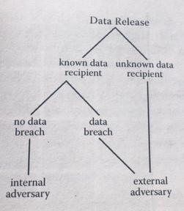
Decision Tree to Determine the Type of Adversary

Slide 8
An Internal Adversary: Attack Scenario 1
There are two general scenarios for a re-identification attack when the adversary is internal
Scenario 1: Data recipient deliberately attempts to re-identify the DF. If there is no contract or data sharing agreement between the data custodian and the data recipient prohibiting such attacks, then one can assume it is plausible that an internal adversary will attempt to re-identify the data
In such case, the Pr(attempt) =1

Slide 9
An Internal Adversary: Attack Scenario 1
If there is a data sharing agreement in place, then the probability of a re-identification attempt will be reduced. The size of the reduction will depend on how well the adversary is able to enforce the agreement and, in general, enforce good practices internally
The stronger the mitigating controls that are in place, the lower the Pr(attempt)
But also the motives and capacity dimension is important since if the adversary has no motive or technical capacity to launch an attack, then the Pr(attempt) will be low
Here is a subjective table of modeling the Pr(attempt) based on industry experts

Slide 10
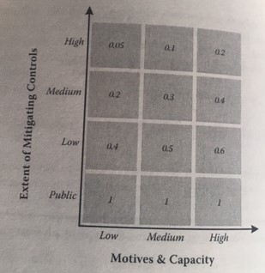
Attack Scenario 1: Matrix of Mitigating Controls and Motives

Slide 11
An Internal Adversary: Attack Scenario 1
Another scheme is to say that if motives and capacity are managed, then we need to focus on the possibility of a rogue employee. If the data set will be assessed by, say, 100 people, how many rogue employees will be (PREFERRED METHOD)?
If there is likely to be only one rogue employee, then we can say that Pr(attempt) = 1/100 = 0.01. If we want to be conservative we can say that 10 of these employees may go rogue, so Pr(attempt) = 0.1
The value of Pr(re-id|attempt), which is the probability of correctly re-identifying a record given that an attempt was made, is computed directly from the data set.

Slide 12
An Internal Adversary: Attack Scenario 2
The second scenario for the internal adversary is when someone employed by the data recipient spontaneously recognizes someone he or she knows in the DF
This individual most likely will be a data analyst
During the analysis of the DF, they recognize a record belonging to someone in his or her circle of acquaintances.
Pr(re-id) = Pr(re-id|acquaintance) x Pr(acquaintance)
Pr(acquaintance) is the probability of the adversary having an acquaintance potentially in the dataset

Slide 13
Attack Scenario 2: Pr(acquaintance)
Pr(acquaintance) = 1 – (1-p)^{m}
p=prevalence of a certain characteristic in the population
m = number of people the adversary know (number of acquaintances)
This is the probability that a random adversary knows a person who has that specific characteristic(s)

Slide 14
Example of
Attack Scenario 2: Pr(acquaintance)
Let us consider an example where a data custodian is disclosing a cancer data set to a researcher
Recall the formula: Pr(acquaintance) = 1 – (1-p)^{m}
If the dataset is of breast cancer patients, this probability is that of a randomly selected member of the population knowing someone who has breast cancer.
Consider that on average people tend to have 150 friends (Dunbar number)
We can also get the prevalence of breast cancer in the population using public data sets (about 13%)
Pr(acquaintance) = 1 – (1-0.13)^{150/2} (we divide the number of friends in half seeing breast cancer is a disease that predominantly affects women)

Slide 15
Attack Scenario 2: Pr(acquaintance)
Pr(acquaintance) = 1 – (1-p)^{m}
p=prevalence of a certain characteristic in the population
m = number of people the adversary know (number of acquaintances)
This is the probability that a random adversary knows a person who has that specific characteristic(s)

Slide 16
Attack Scenario 3: Data Breach
An External Adversary
If a data set is disclosed to a known data recipient, then an external adversary would be relevant if there is a data breach and the DF is inadvertently or deliberately exposed outside the data recipient
Current evidence suggests that most breaches occur through loses or thefts of mobile devices
Approximately 27% of health care organizations suffer a data breach!

Slide 17
Attack Scenario 3: Data Breach
An External Adversary
The probability model is:
Pr(re-id) = Pr(re-id|breach) x Pr(breach)
For health care data organizations, Pr(breach) = 27%
This probability is likely to change over time!
As with attacks 1 and 2, Pr(re-id|breach) is computed from the data itself

Slide 18
Attack Scenario 4: Public Data
An External Adversary
The final attack we consider is when data is disclosed publicly.
We can assume with certainty that there is an adversary who has background information that can be used to launch an attack on the data: Pr(attempt =1)
We therefore only consider the probability of re-identification from the dataset:
Pr(re-id)

Slide 19
Probability Metrics to Measure Pr(re-id|attempt)
When we release a data set, we can assign a probability of re-identification to every single record.
To manage the risk of re-identification, however, we need to assign an overall probability value to the whole data set. This allows us to decide whether the whole data set has an acceptable risk.
There are two general approaches that we use: maximum risk and average(median) risk

Slide 20
Probability Metrics: Maximum Risk v. Median Risk
With the maximum risk approach, we assign the overall risk to the record that has the highest probability of re-identification
The key assumption here is that the adversary is attempting to re-identify a single person in the data set, and the adversary will look for the target record that has the highest probability of being re-identified
On the other hand, if the adversary is trying to re-identify an acquaintance, any one of the records can be the target, so it’s fair to use a form of average risk.
Records that belong to the same equivalence class have the same probability of re-identification

Slide 21
First Example
An adversary is attempting to re-identify a specific target, Alice.
Here is the original data set:

Slide 22
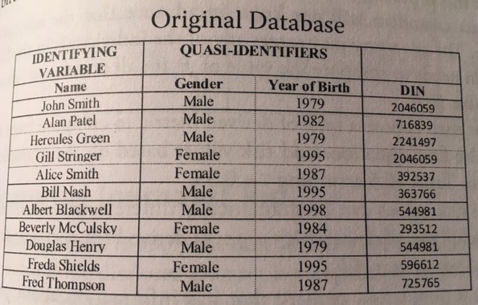
First Example

Slide 23
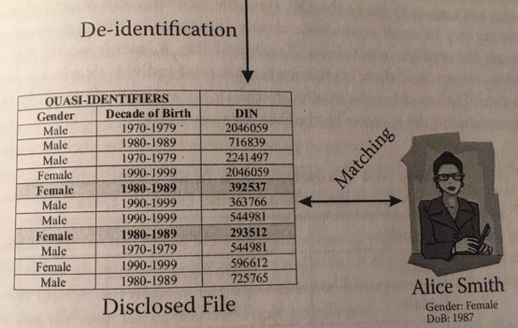
First Example

Slide 24
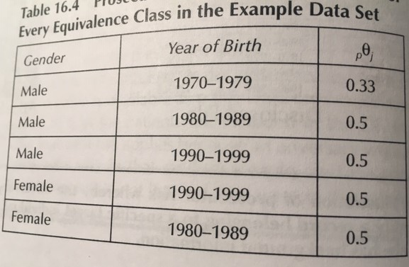
First Example

Slide 25
Calculated Risks
Maximum risk = 50%
Average risk = Number of ECs / Number of Records = 5/11 = 45%
Risk Threshold = Usually 33% in the health care industry

Slide 26
Questions?

